Slide 1
Kafka
Group 06
Mushafiq Fakki

Slide 2



Team Members:
Vamshi Krishna Nuka
Mushafiq Fakki
Ankit Prakash
Venkata Sai Krishna Dasari
Mushafiq Fakki

Slide 3
Agenda
What is Apache Kafka?
Why Kafka?
Kafka Architecture
What is Zookeeper?
Demo
Mushafiq Fakki

Slide 4
What is Apache Kafka?
Kafka is a streaming platform.
Kafka was originally developed by at LinkedIn in 2011
Mushafiq Fakki

Slide 5
What is Apache Kafka?
Unlike messaging platform, Kafka can handle trillions of events a day
Kafka is used heavily in the big data space as a reliable way to ingest and move large amounts of data very quickly

Slide 6
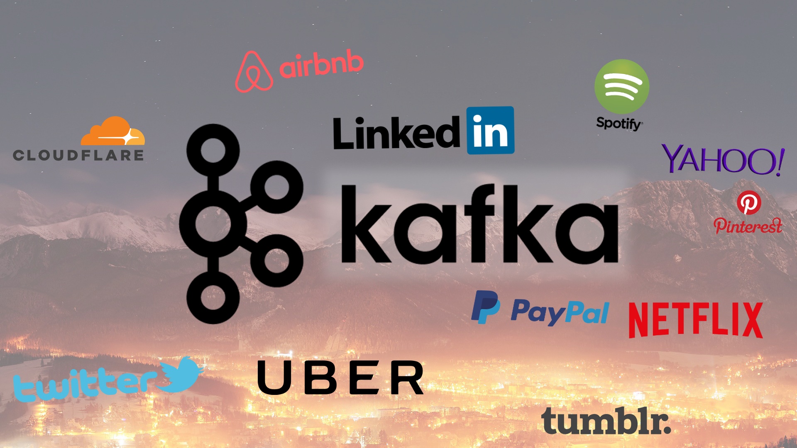

Slide 7
Kafka Terminology
Producer
Consumer
Broker
Cluster
Topic
Partitions
Offset
Consumer Groups
Venkata

Slide 8
Kafka Terminology
Producer - An application that sends messages to kafka.
Consumer - An application that reads the messages from kafka.
Requests for messages
Producer
messages
Producer
Consumer
messages
Venkata

Slide 9
Why Kafka?
Kafka provides low-latency, high-throughput, fault-tolerant
Kafka can work with Flume/Flafka, Spark Streaming, Storm, HBase, Flink, and Spark for real-time ingesting, analysis and processing of streaming data
Ankit

Slide 10
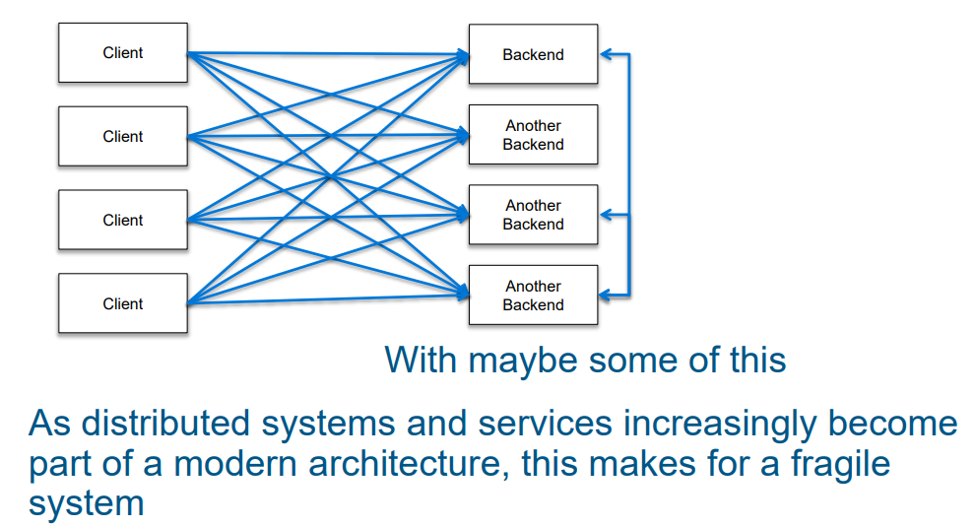
Ankit

Slide 11
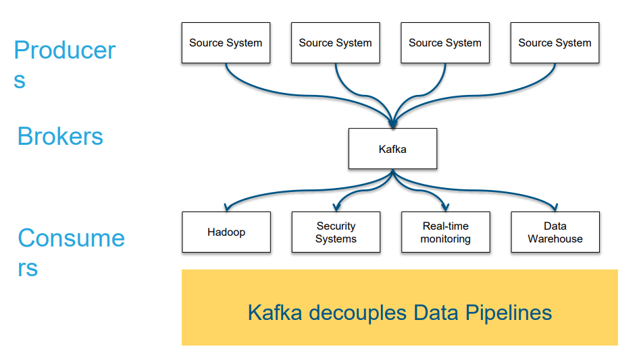
Ankit

Slide 12
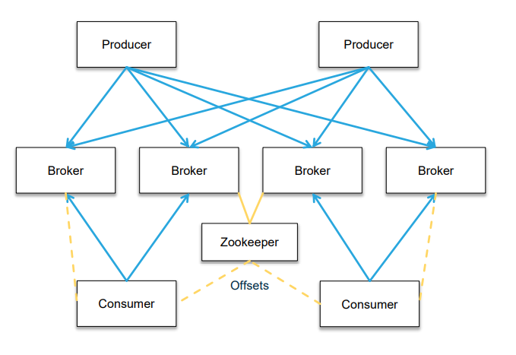
Architecture
Ankit

Slide 13
What is Zookeeper?
Zookeeper is a distributed key-value store.
It is highly-optimized for reads but writes are slower.
It is most commonly used to store metadata and handle the mechanics of clustering.
It allows clients of the service (the Kafka brokers) to subscribe and have changes sent to them once they happen.
Vamshi

Slide 14
Is Zookeeper Fault - tolerant?
Vamshi

Slide 15
Yes, Zookeeper is Fault-tolerant.
Kafka is fault-tolerant and it heavily depends on zookeeper.
So it is must for zookeeper to be fault-tolerant.
Vamshi

Slide 16
DEMO
Ankit

Slide 17
Thank you
Any questions?

